Slide 1
Young People & Stalking

Slide 2
What is stalking and harassment?
Stalking is a pattern of fixated and obsessive behaviour which is repeated, persistent, intrusive and causes fear of violence or engenders alarm and distress in the victim.

Slide 3
Definition of stalking and harassment
Harassment
Repeated unwanted behaviour that offends someone or makes them feel distressed.
Stalking
A pattern of unwanted and persistent behaviour motivated by a fixation or obsession towards a person that causes them to feel distressed or fearful.

Slide 4
FOUR
Fixated
Obsessive
Unwanted
Repeated

Slide 5
Statistics and context
77% experienced at least one repeated harmful behaviour consistent with stalking.
Rising to 87% who identified as female, non binary or other.
84% experienced behaviours consistent with online stalking.
70% experiencing in-person stalking behaviours.
88% stated it had a harmful impact on their wellbeing.
33% felt like the behaviour was their fault
15% said they have self harmed as a result

Slide 6
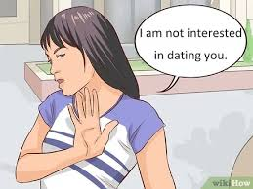
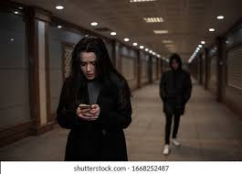
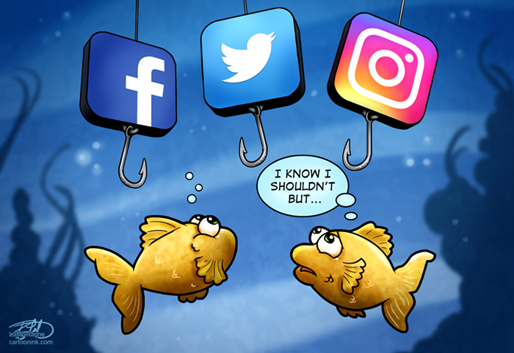
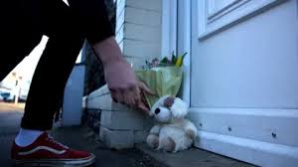
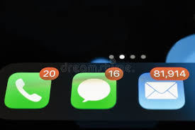
Tactics of a stalker
Fear of someone who won't leave you alone or take no for an answer!
Monitoring someone online activity
Following someone
Sending repeated unwanted gifts.
Unwanted messages/Text and emails

Slide 7
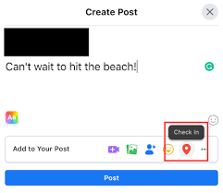
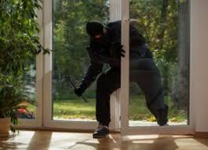
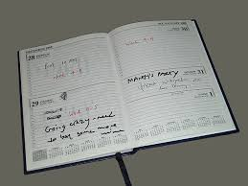
Tactics of a stalker
Loitering outside someone's home
Tracking your through social media and location
Trespassing into your home.
Knowing your routine and Schedule

Slide 8
What could it look like for young people?
Knows your routine/ schedule
Shows up at the same places or events
Drives past your home, workplace, college, Uni etc..
Taking pictures of you
Writes letters or leaves notes constantly
Steals things that belong to you
Damages property
Spreads false rumors or information about you

Slide 9
What does a stalker look like?
Ex partner
Someone you have never met just crossed paths or been seen on social media.
Someone you went on a date with.
Someone you have had a casual/ sexual relationship with
Someone you have had a disagreement with

Slide 10
Who can be a victim of stalking?
ANYONE can be a victim of stalking
ANY AGE – We have support victims whose stalking begun when they were 10 years of age and elderly victims.
ALL VICTIMS are spread across the entire socio-economic spectrum and a large proportion (38%) are professionals.
Anyone can become a victim of stalking and the only way to avoid doing so would be to avoid the social world.

Slide 11
Why are young people so at risk?
Normalisation of stalking.
Moving away from home to university.
Excitement of attention from older men/women; Making them feel more mature.
Lack of understanding; what stalking is?
High levels of social media
Unaware of the risks of social media and uploading of personal information/locations
Having large amounts of followers; not knowing who the stalker is or that they are being stalked due to the volume of people looking at their social media.

Slide 12
#Following

Slide 13
Digital, Cyber Stalking & Safety Planning

Slide 14
Cyber-stalking
Cyber Stalking includes any form of online harassment where perpetrators use technology to send threatening messages, calls or photos to their victims. Cyberstalking can additionally include gaining access to online accounts, the sharing of private information and sexual harassment.
67% of stalking victims know their stalker, the rest could be someone they have never met.
16% of cyberstalking victims age 16-24 said their stalker shared sexually explicit photos or videos without consent.
In the past 3 years there has been an increase of 359% in Cyber stalking.

Slide 15
A safe, relaxing room?
Can you spot any cyber risks?
Notes:
Lighting controls
Door Control
Motion sensors
Heating control
Security and alarms
Alexa / Google Nest
Spycams
Smoke Detectors

Slide 16
Smoke detector?
A safe, relaxing room?
What it looks like in reality.
Heating controls
Lighting controls
WiFi
Smart blinds
Spycams?
Motion sensors?
Mobiles and Tablets – potential spyware
Alexa
Notes:
Lighting controls
Door Control
Motion sensors
Heating control
Security and alarms
Alexa / Google Nest
Spycams
Smoke Detectors

Slide 17
Social media
Persistently liking your stories and posts
Repeatedly messaging you without any response. They may
States they know you have read message ( two ticks)
Finding you in real life by using data provided in snap maps. – Snap maps doesn’t notify you if someone has checked your location.
Regular screenshots of your story.
Linking in with your close mates.
Knowing password and log in details and using these to gain information.
Setting up fake accounts.

Slide 18
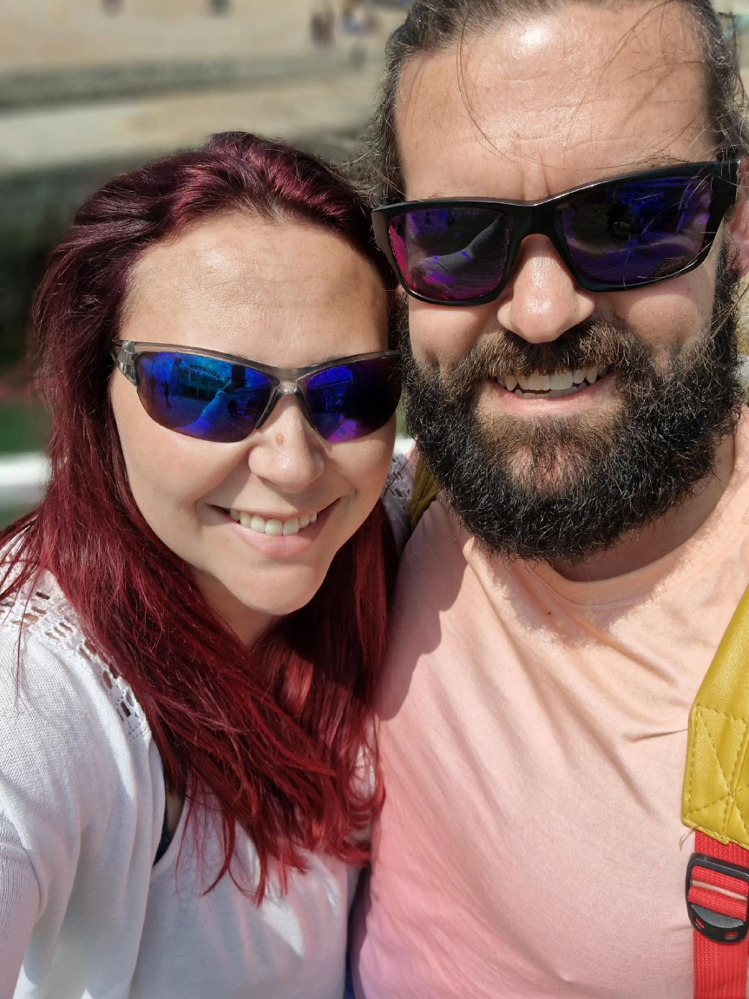
What do you see?
A fun selfie?
Perhaps posted by you or a friend on social media…
Notes:
How could this put a victim at risk?
Encourage group engagement.
Can they tell where I am?

Slide 19
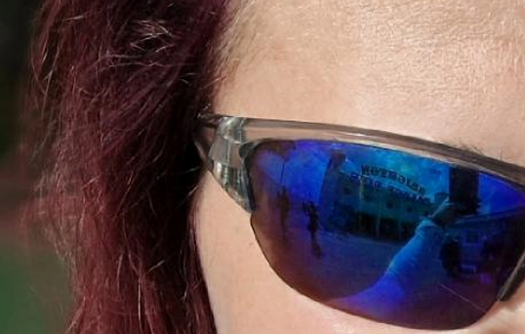
Notice anything?
Notes:
Ask workshop delegates

Slide 20
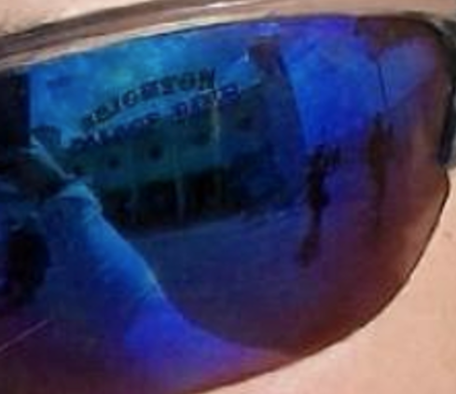
Can you work out where she is?
Mirror image
of photo…

Slide 21
Air Tags
Air tags are great if you're heading off on holiday soon and want to monitor your luggage, or you're prone to misplacing your car keys, purse or wallet, you might be tempted by the Apple AirTag - a Bluetooth gadget you can attach to your belongings to track their location.
The Air tag is a gadget the size of a 10p coin, and this has facilitated a boom in terrifying behavior from abusers
It’s so small, it’s unnoticeable and very user-friendly. It doesn’t require any technical skill whatsoever and it is relatively cheap to buy .
Some victims found an air tag device had been slipped into their pockets or bag.

Slide 22
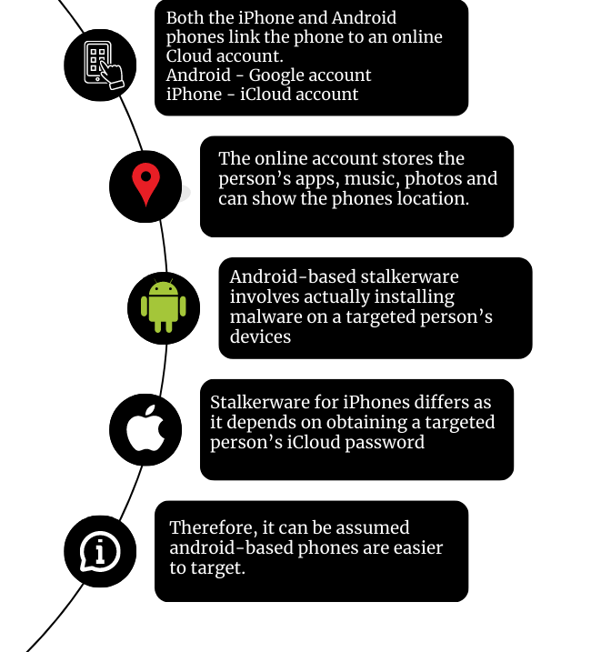
How stalkers can access
mobile phones

Slide 23
Cyber Stalking Video

Slide 24
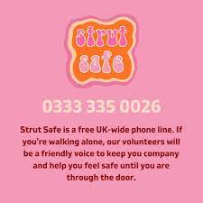
General safety planning

Slide 25
Keeping yourself safe
Easily guessable passwords can be discovered by a stalker, so make sure you create a secure one. Not your name, DOB, pet names etc..
If apps offers 2-step verification (2SV), turn it on. 2SV (which is sometimes called multi-factor authentication or MFA) provides a way of 'double checking' that you really are the person you are claiming to be.
Be aware of what images you post online; background what you're wearing i.e uniform. Don't post things on the day; wait a few days.
Do not share compromising pictures of yourself - these can be used and changed Ai deep fakes

Slide 26
Keeping yourself safe
Ensure privacy setting on your account.
Make sure you know who you're accepting as a friend.
Report fake accounts to FB/TikTok/Instagram etc..
Do not share bank account details online with people you do not know.
If you decide to meet someone you met online – meet with caution. Let friends know where you will be, times and remember ask for Angela at the bar if you need support to get away.

Slide 27
Keeping yourself safe at work / education
What the stalker may do? | Safety planning tips | Evidence gathering
Follow you to, from and around the location. Contact collogues and friends about you. Show up. Contacting by text, phone or email whilst at work or in education | Give picture of stalker to friends at work or school etc.. Consider changing routes to work/ college Adjust hours if possible. Have a colleague walk you to and from the car/bus stop. Ensure work and education aware to not provide your number to anyone. Any protective orders - ensure this is shared with bosses/ teachers. | Save any texts / Voicemails. If CCTV and stalker turning up ensure you work with security/ bosses to save this for evidence.

Slide 28
Keeping yourself safe at home
What the stalker may do?​ | Safety planning tips​ | Evidence gathering​
Follow you to, from and around your home.​ Invade your home​ Damage property.​ Hack into wireless networks or home devices​ Disconnect power / Internet.​ Send gifts / email / calls and text.​ Install camera to monitor.​ | Inform Neighbours about situation. Ensure description and photos is shared.​ Pack emergency bag with important documents incase need to leave quickly.​ Identify escape routes and ensure children are aware.​ Change locks and upgrade security systems.​ | Consider installing own camera to capture evidence.​ Photograph property damage​

Slide 29
Keeping yourself safe Technology
What the stalker may do?​ | Safety planning tips​ | Evidence gathering​
Contacting by text, phone or email.​ Tracking / Monitor through GPS, Spyware and/or social media.​ Set up fake social media accounts.​ Hack into online accounts.​ Share personal and private images with each other.​ Film the victim without consent.​ | Update passwords​ Change answer to security questions so stalker cant reset password.​ Location setting off- only have on for app like Hollie Guard.​ Complete internet search of name to ensure no personal information has been posted.​ If fear of Spywear use a different device​ Download Avast app​ ​ | Screenshots of internet communication.​ Get second camera to capture disappearing messages or might notify sender if screenshot taken.​ Phone records from provider to show volume of calls.​ Document all incidents​ ​

Slide 30
Referral pathway
stalking@stopdomesticabuse.uk
stalking.service@stopdomesticabuse.cjsm.net
Call for advice on 03300 533630

Slide 31
Any questions?

